Slide 1

Securing IoT

Slide 2
Content
Introduction
Design for protection
Privacy and ethics
Security

Slide 3
Introduction
Securing IoT
https://courses.edx.org/courses/course-v1:CurtinX+IOT1x+2T2018/jump_to/block-v1:CurtinX+IOT1x+2T2018+type@vertical+block@2d1cf5960ba04aa99e6fa50474e7c208

Slide 4
Note
The internet of things will provide further ways for hackers to attack businesses and lives.
Data about you is being sent everywhere, all the time.
Security certainly needs to be carefully worked out and added to the design of a system across every path; devices, the network, programs, and data.

Slide 5
Securing IoT
Security and privacy implications of IoT overview
https://courses.edx.org/courses/course-v1:CurtinX+IOT1x+2T2018/jump_to/block-v1:CurtinX+IOT1x+2T2018+type@vertical+block@2ed3e012672f4f85965cee51f0b0e7a7

Slide 6
Note
IoT Security Issues:
Security risks existed before IoT, but IoT increases and intensifies them.
Issues in the Cloud:
• DATA PRIVATE - Prevent misuse of data, keep private data private.
• DATA ACCESS - Protect data from being stolen or corrupted.
Issues in the Network:
• UNAUTHORISED ACCESS - Protect network devices from unauthorised contact.
• SECURE NETWORK - Protect wireless networks.
Issues in the Network and the Cloud:
• DATA THEFT - Protect data from being stolen or corrupted.

Slide 7
Note
There are some additional security risks that come with connecting up ‘things’ to the internet.
Issues in the Cloud and the Network:
• SECURE M2M - Machine to machine interaction must be robust and secure.
Issues with Devices:
• HACKED AND BROKEN – Protect devices from being hacked and stopped from working as required.
• HACKED AND MIS-USED – Protect devices from being hacked and used to damage other devices or operations.
There are many security risks to consider with IoT. They can be both physical (eg stolen device) or digital (eg stolen data.)

Slide 8
Securing IoT
Hackable devices
https://courses.edx.org/courses/course-v1:CurtinX+IOT1x+2T2018/jump_to/block-v1:CurtinX+IOT1x+2T2018+type@vertical+block@7c77277f01a94c59899244c3a5104a8d

Slide 9
Securing IoT
Cyber security methods
https://courses.edx.org/courses/course-v1:CurtinX+IOT1x+2T2018/jump_to/block-v1:CurtinX+IOT1x+2T2018+type@vertical+block@2da9e785c61f4946947749e526d35ca0

Slide 10
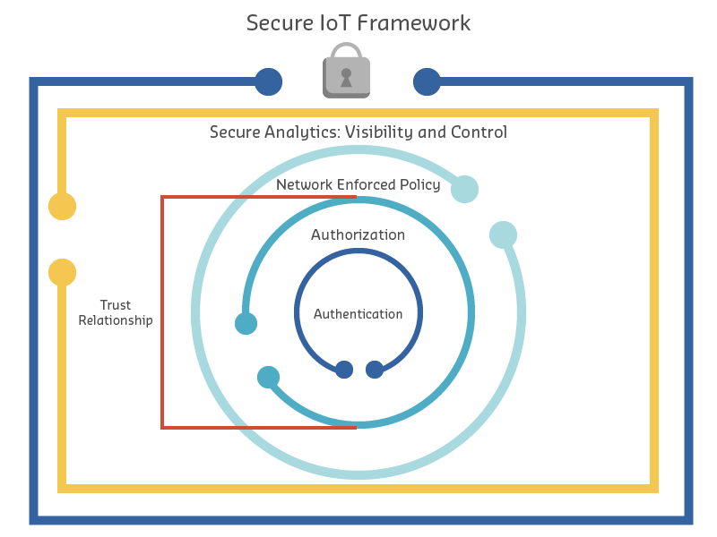
Note

Slide 11
Note
It outlines the following components:
Authentication – IoT devices connecting to the network create a trust relationship, based on validated identity through mechanisms such as: passwords, tokens, biometrics, RFID, X.509 digital certificate, shared secret, or endpoint MAC address.
Authorisation – a trust relationship is established based on authentication and authorisation of a device that determines what information can be accessed and shared.
Network Enforced Policy – controls all elements that route and transport endpoint traffic securely over the network through established security protocols.
Secure Analytics: Visibility and Control – provides reconnaissance, threat detection, and threat mitigation for all elements that aggregate and correlate information.

Slide 12
Securing IoT
Activity: Identifying IoT security risks
https://courses.edx.org/courses/course-v1:CurtinX+IOT1x+2T2018/jump_to/block-v1:CurtinX+IOT1x+2T2018+type@vertical+block@6e3587f53bca46c3831a63d99f3e1a85

Slide 13
Note
Consider three scenarios:
a smart agricultural watering system
a heart monitor connected to a doctor’s surgery, and
an industrial application where fans are listened to for early detection of failure.
For each scenario, a risk has been identified. You need to decide:
How high the level of impact will be if the risk comes about?
How likely is it that the risk will occur?
What security measures should be taken to reduce the risk?

